Slide 1

Feature Engineering (FE) & Exploratory Data Analysis (EDA)
Varadharajan Suresh

Slide 2

Contents
EDA
Seasonal-Trend Decomposition
FbProphet Module
Simple Moving Average and Exponential Smoothing

Slide 3
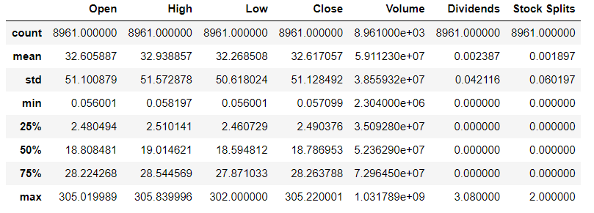
About the Data
The data is obtained from Yahoo Finance leveraging the Yfinance package. We get 7 columns and 5 of them namely Open, High, Low, Close and Volume are of interest.

Slide 4
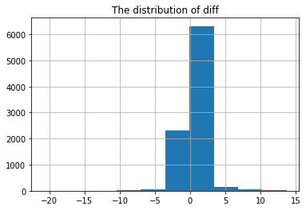
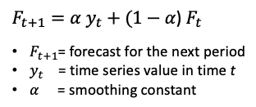
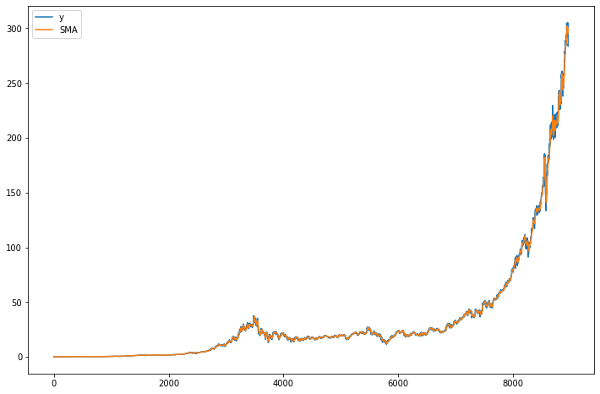
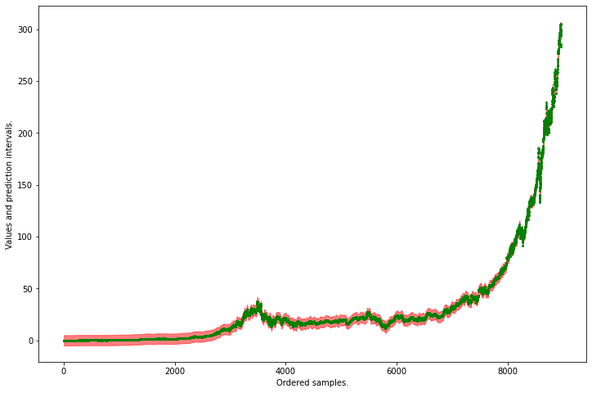
Simple Moving Average and Exponential Smoothing
Notes:
Simple Moving Average: SMA is an arithmetic moving average calculated by adding recent prices and then dividing that figure by the number of time periods in the calculation average. The SMA method smooths the rough edges in a time series in order to identify the pattern.
Exponential Smoothing: It is similar to SMA in smoothing the rough edges in order to identify a pattern, but the weights placed on each observation changes. Older the observation lesser the weight placed on it and newer the observations have higher weightage. This gives more importance to the recent and relevant data.

Slide 5
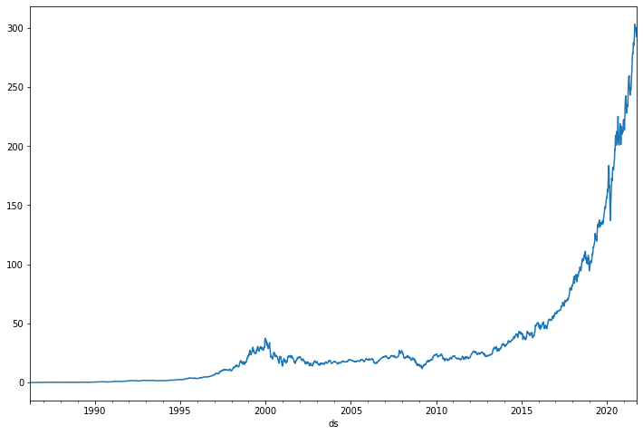
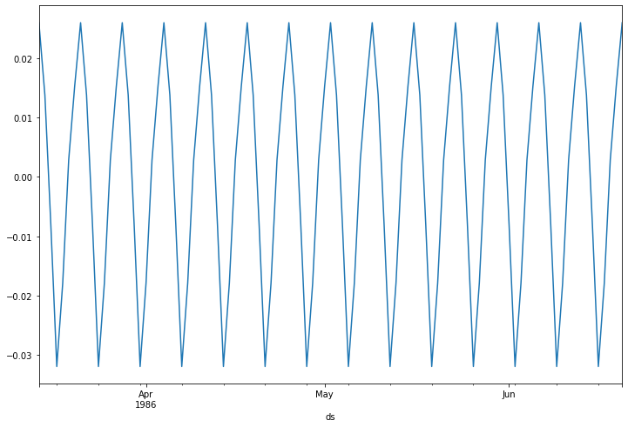
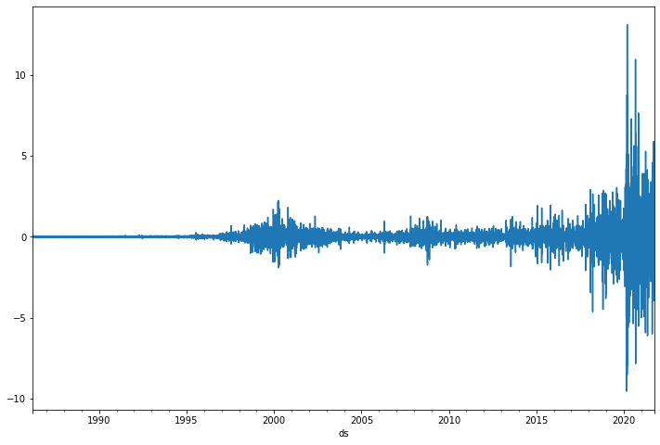
Seasonal-Trend Decomposition
Trends
Seasonal
Residuals
Notes:
Seasonal Treanding Decomposition: STD is splits the timeseries data into 3 parts Trends, Seasonal and residue.Trend gives you a general direction of the overall data.seasonality is a regular and predictable pattern that recur at a fixed interval of time. Randomness or Noise or Residual is the random fluctuation or unpredictable change. This helps identify the change in pattern over various seasons and historically.

Slide 6
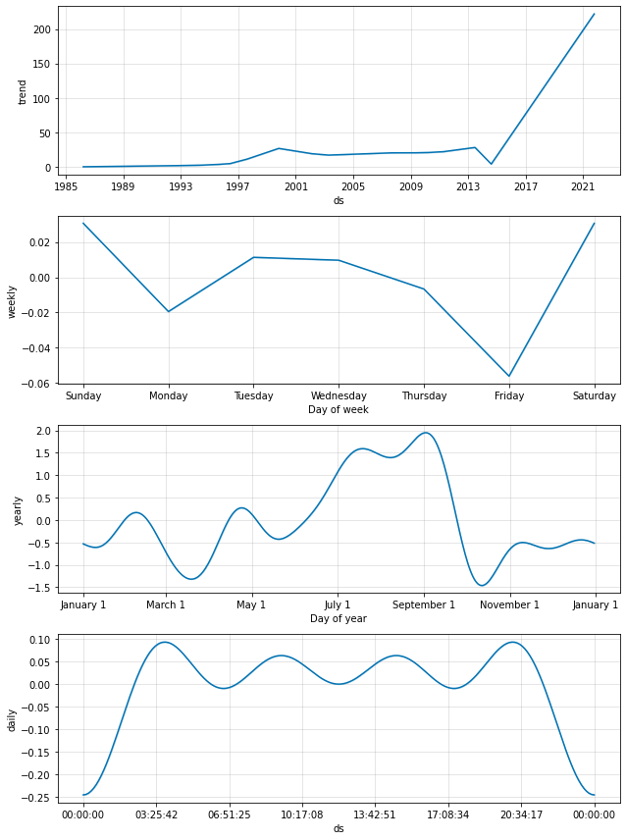
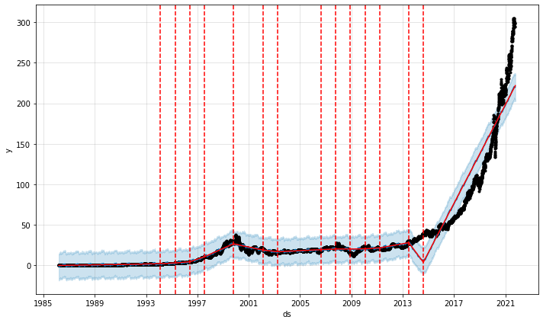
Prophet module
Notes:
The fbProphet Module: fbProphet is a open-source procedure developed by Facebook for forecasting time series data based on an additive model where non-linear trends are fit with yearly, weekly, and daily trends, plus holiday effects. Prophet is robust to missing data and shifts in the trend, and typically handles outliers well

Slide 7

Thank you

